Slide 1
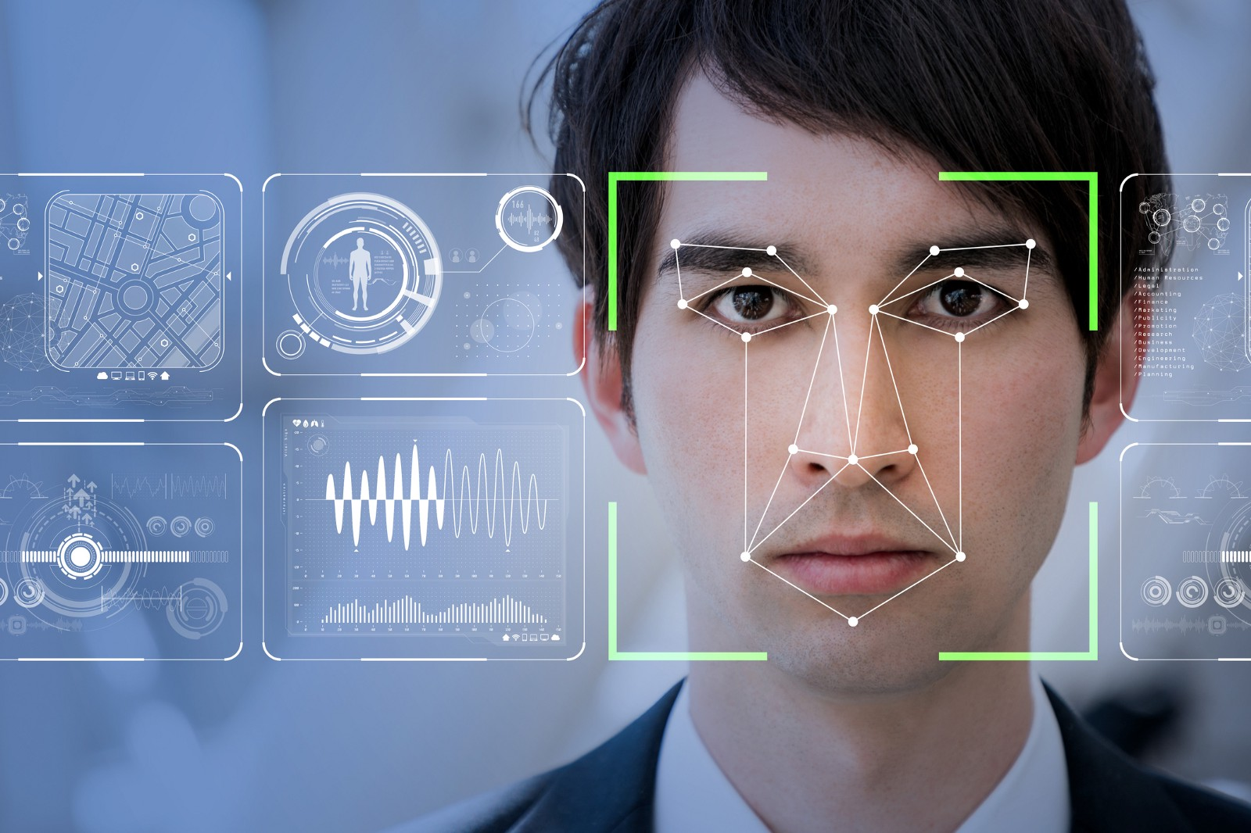
Face Recognition

Slide 2
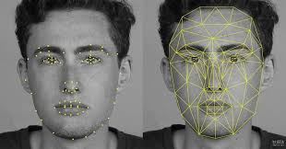
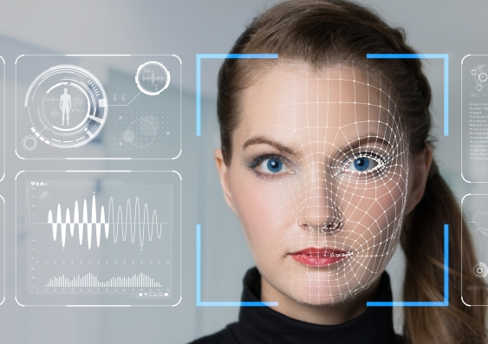
Face Recognition
Notes:
Facial recognition is a category of biometric software that maps an individual's facial features mathematically and stores the data as a faceprint. The software uses deep learning algorithms to compare a live capture or digital image to the stored faceprint in order to verify an individual's identity

Slide 3

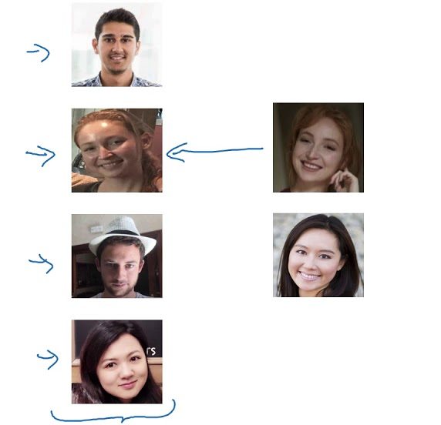
￼
One Shot Learning
One-shot learning aims to learn information about object categories from one, or only a few, training images.
One-shot learning can be implemented using a Siamese network.
Learning from one or few examples
To recognize the person again

Slide 4
How a Facial recognition using Deep Learning works?

Slide 5
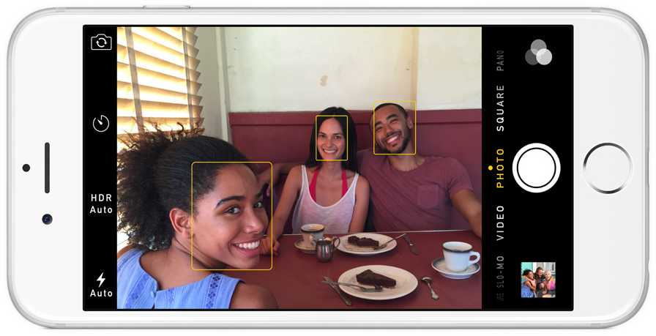
Step 1: Finding the Faces
Histogram of Oriented Gradients(2005)
Notes:
We’re going to use a method invented in 2005 called Histogram of Oriented Gradients — or just HOG for short.

Slide 6
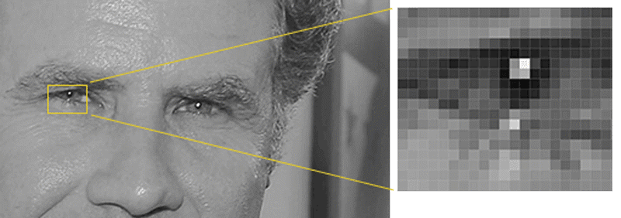
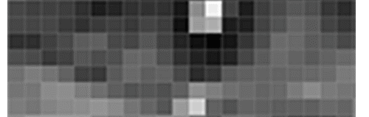
Notes:
Look at the direct pixel around.
figure out how dark the current pixel is compared to the pixels directly surrounding it. Then we want to draw an arrow showing in which direction the image is getting darker:

Slide 7
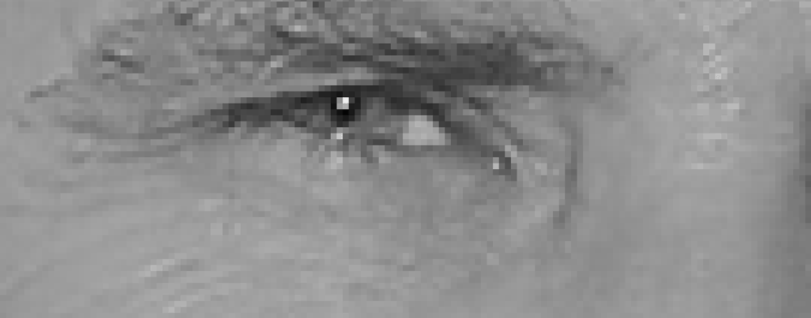
Notes:
If you repeat that process for every single pixel in the image, you end up with every pixel being replaced by an arrow. These arrows are called gradients and they show the flow from light to dark across the entire image
If we analyze pixels directly, really dark images and really light images of the same person will have totally different pixel values. But by only considering the direction that brightness changes, both really dark images and really bright images will end up with the same exact representation. That makes the problem a lot easier to solve!
But saving the gradient for every single pixel gives us way too much detail.

Slide 8
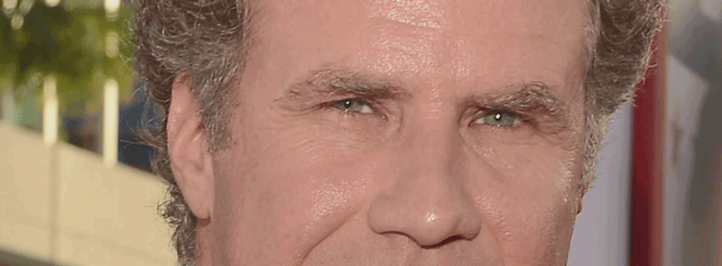
Notes:
To do this, we’ll break up the image into small squares of 16x16 pixels each. In each square, we’ll count up how many gradients point in each major direction (how many point up, point up-right, point right, etc…). Then we’ll replace that square in the image with the arrow directions that were the strongest.

Slide 9
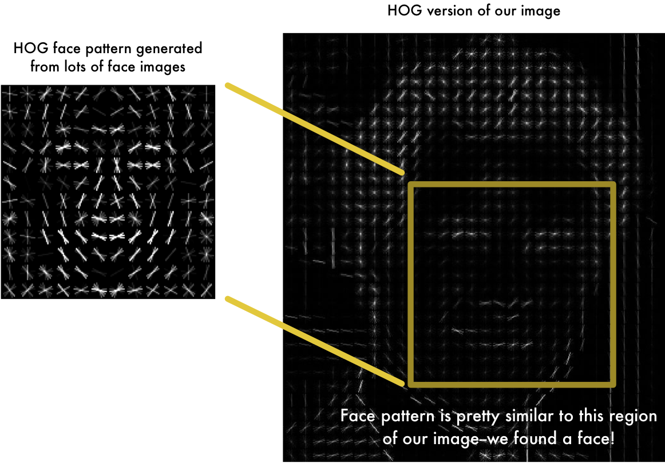
Find the part of our image that looks the most similar to a known HOG pattern that was extracted from a bunch of other training faces
Notes:
The original image is turned into a HOG representation that captures the major features of the image regardless of image brightness.

Slide 10
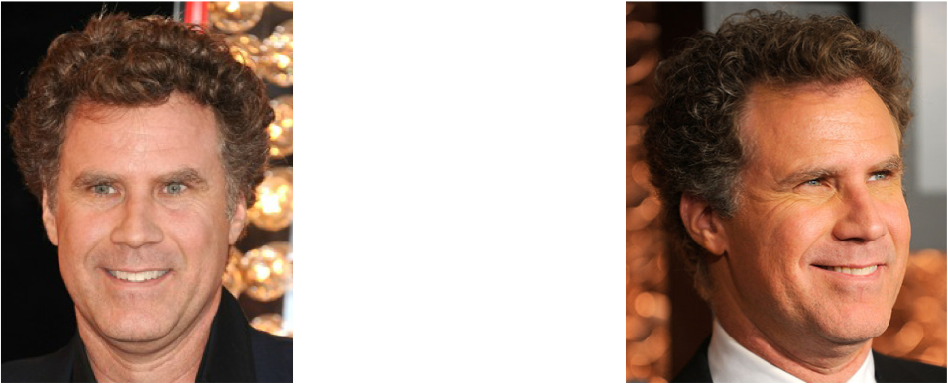
Step 2: Posing and Projecting Faces
Notes:
Humans can easily recognize that both images are of same person
But computers would see these pictures as two completely different people.
To solve this problem we use Face Landmark Detection

Slide 11

Face Landmark detection
Approach invented in 2014 by Vahid Kazemi and Josephine Sullivan
We will come up with 68 specific points (called landmarks) that exist on every face — the top of the chin, the outside edge of each eye, the inner edge of each eyebrow, etc.

Slide 12
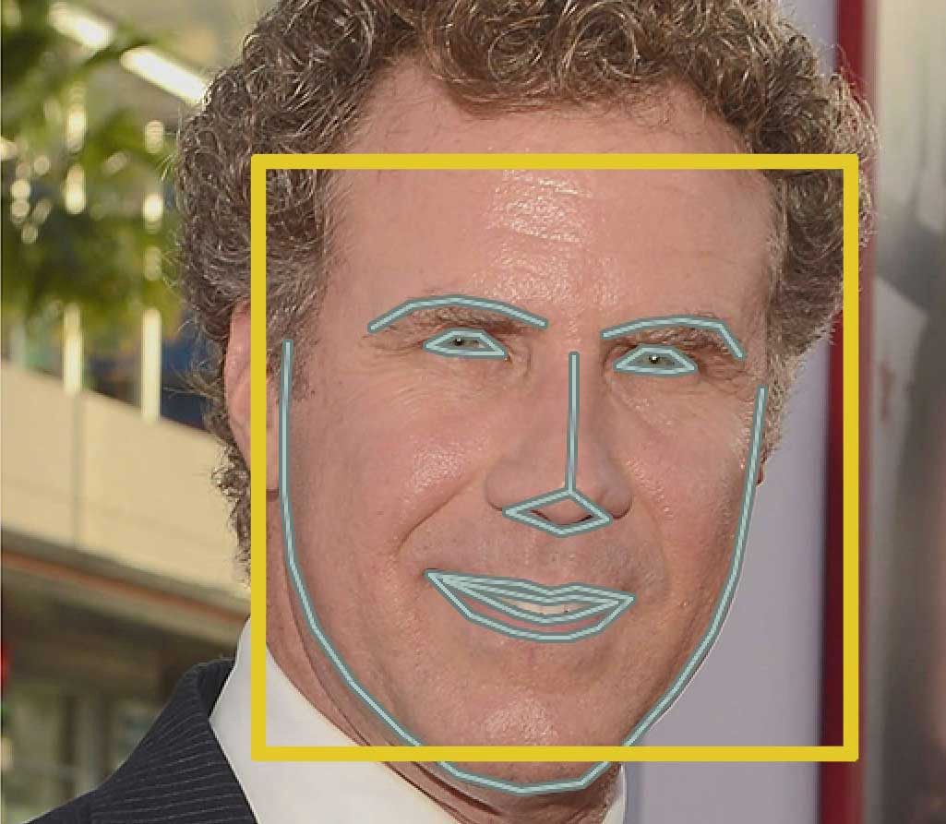
Notes:
result of locating the 68 face landmarks on our test image

Slide 13
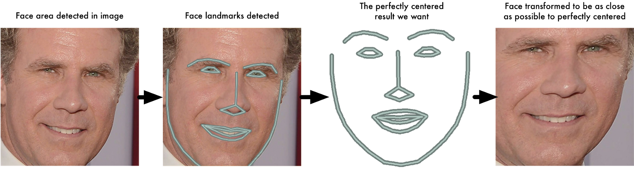
Image Augmentation
Now as we know here eyes, mouth,etc are, we’ll simply rotate, scale and shear the image so that the eyes and mouth are centered as best as possible.
Using basic image transformations like rotation and scale that preserve parallel lines (called affine transformations)
Notes:
result of locating the 68 face landmarks on our test image

Slide 14
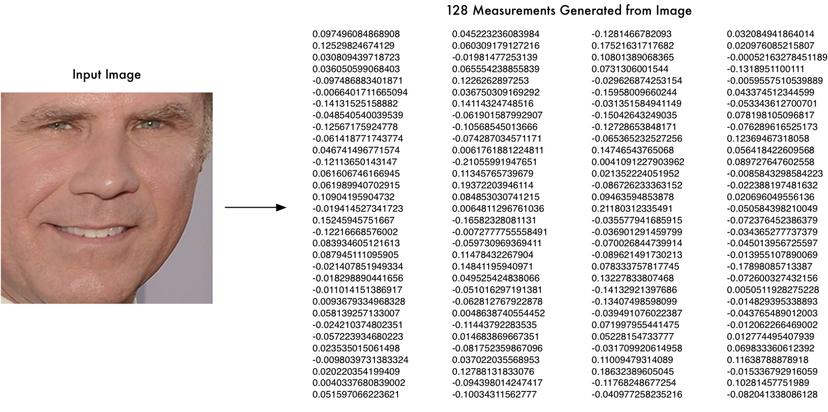
Step 3: Encoding Faces
Notes:
The simplest approach to face recognition is to directly compare the unknown face we found in Step 2 with all the pictures we have of people that have already been tagged. When we find a previously tagged face that looks very similar to our unknown face, it must be the same person.

Slide 15
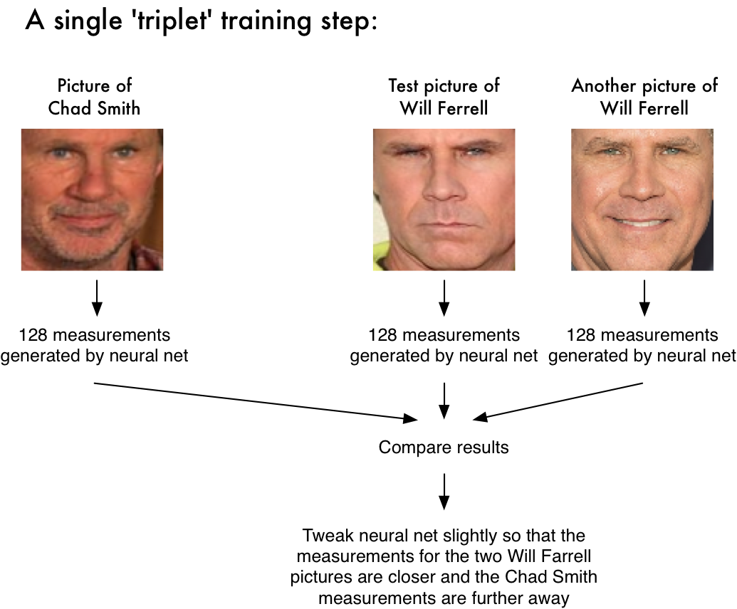
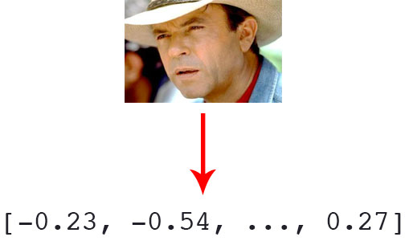
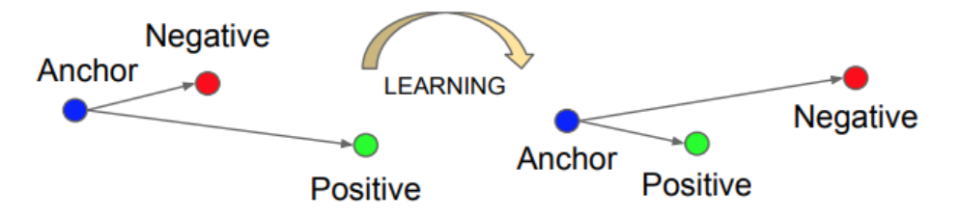
Notes:
Then the algorithm looks at the measurements it is currently generating for each of those three images. It then tweaks the neural network slightly so that it makes sure the measurements it generates for #1 and #2 are slightly closer while making sure the measurements for #2 and #3 are slightly further apart:
After repeating this step millions of times for millions of images of thousands of different people, the neural network learns to reliably generate 128 measurements for each person. Any ten different pictures of the same person should give roughly the same measurements.

Slide 16


Slide 17
Network architecture : ResNet-34 From the Deep Residual Learning for Image Recognition paper by He et al., Uses pre trained model by Davis King trained on a dataset of ~3 million images.
Notes:
Davis Creator of Dlib
On the Labeled Faces in the Wild (LFW) dataset the network compares to other state-of-the-art methods, reaching 99.38% accuracy.
The face_recognition library, created by Adam Geitgey, wraps around dlib’s facial recognition functionality, making it easier to work with.

Slide 18
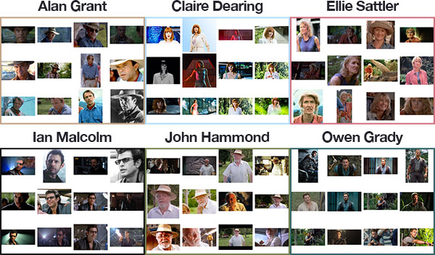
Our face recognition dataset

Slide 19
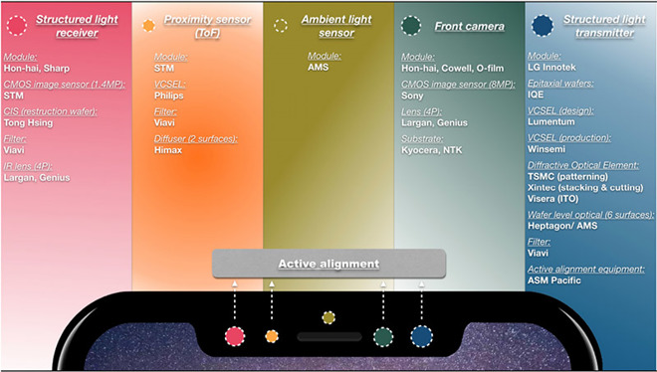
Limitations of Image Facial Recognition
Notes:
Facial Recognition just using images is not perfect but if combined with different sensor data like done in iPhoneX could make it perfect

